Slide 1
flodym: A library for dynamic material flow analysis
Brightcon 2025
Jakob Dürrwächter With: Bennet Weiß, Merlin Hosak, Falko Ueckerdt

Slide 2
Motivation
What is MFA?
Mass balance: Tracks material through system along life cycle stages
Why Dynamic MFA (In the context of LCA)
Stock-and flow time dynamics
Future demands
Secondary material availability
Temporal inter-dependency
Circular economy interventions
Concise and complete map of single materials’ social metabolism
Don’t take my word for it
Review paper¹ found 200 studies on LCA-MFA combination
DdS Autumn school
¹Barkhausen et al. 2023, J. Clean. Prod. https://doi.org/10.1016/j.jclepro.2023.137017

Slide 3
Why Flodym?
ODYM by Stefan Pauliuk¹
Great concept: abstraction, data classes
> 100 citations
But: Doesn’t make full use of available data structures
Flodym
Objects & structure similar to ODYM
Integrated dimension management
Other functional extensions & API streamlining
Complete refactor/rewrite with current software development practices
→ Flexible, extensible, clean and simple application
¹https://github.com/IndEcol/ODYM

Slide 4
Outline
Material Flow Analysis
Overview
Flodym Features
Arrays & Dimension Management
Other features: Stocks, MFA System, I/O
Application Example
REMIND-MFA

Slide 5
Dynamic Material Flow Analysis
Introduction

Slide 6
Example Research Question
You’d like to compare the future emission intensity of automobile production in the EU and the US.
For this, you need the future share of steel production from scrap
→ How much steel is produced from scrap in these regions in the future?

Slide 7
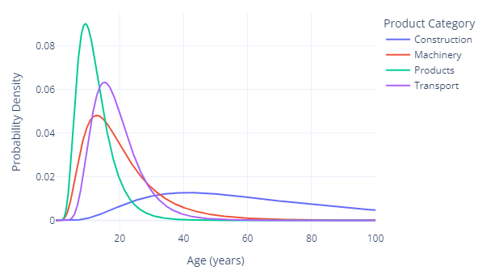
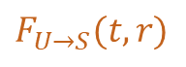
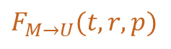
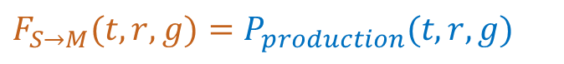
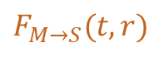
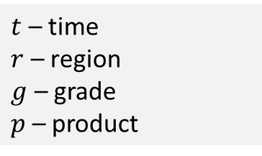
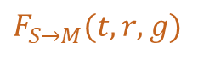

How does dynamic MFA work?
Vocabulary
System environment
Process
$$F_{S→M}(t,r,g)$$
$$F_{M→U}(t,r,p)$$
$$F_{U→S}(t,r)$$
Flow
Raw Steel Production
Manu-facturing
Use
Recycling
Use
Stock
Dynamic Stock:
Lifetime distribution functions
Different stock types: Inflow-driven, stock-driven, …
$$P$$
Parameter
$$F_{M→S}(t,r)$$
Dimensions
$t$ – time
$r$ – region
$g$ – grade
$p$ – product
$F_{S→M}(t,r,g)=P_{production}(t,r,g)$
$F_{M→S}\left(t,r\right) =F_{S→M}(t,r,g)∗P_{loss_rate}(t)$
$F_{M→U}\left(t,r,p\right)=(F_{S→M}\left(t,r,g\right)−F_{M→S}\left(t,r\right))∗P_{product_share}\left(r,p\right)$
$F_{U→S}(t,r)=S_{U}(F_{M→U}(t,r,p), P_{lifetime}(p))$

Slide 8
Flodym Features
Introduction

Slide 9
Flodym Functionality
Handles operations of/between multi-dimensional arrays
Embedded in MFASystem class, with mass balance checks
Integrates dynamic stock models
System definition & data read-in
Plotting and data export
Different degrees of integration / customization

Slide 10
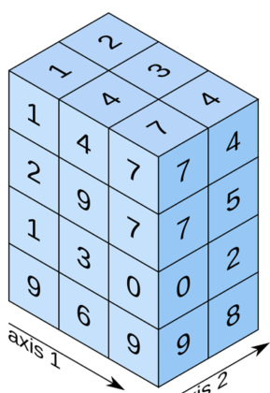
Dimension Management: FlodymArrays
FlodymArray
dims: DimensionSet
values: np.ndarray
“t”
“Time”
“r”
“Region”
“p”
“Product”
2020
2030
2040
2050
“EUR”
“USA”
“CHA”
“Vcl”
“Bld”
FlodymArrays are used
As Flows
As Parameters
In Stock Models (inflow, outflow, stock)

Slide 11
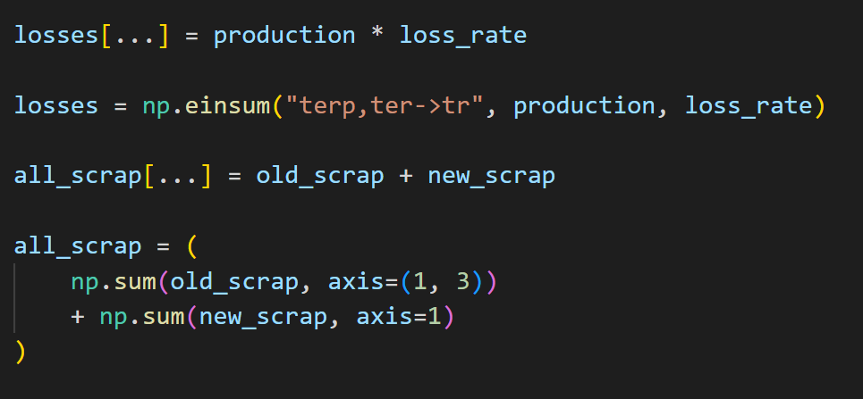
Math operations
Multiplication:
Addition:
flodym
numpy
flodym
numpy
Advantages:
Easy to write
Easy to read/understand
Adding/removing/reordering dimensions requires no changes
Reduces human error

Slide 12
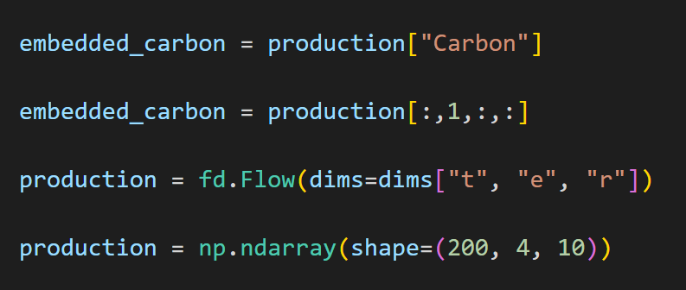
Indexing & Initialization
Indexing:
Initialization:
flodym
numpy
flodym
numpy
Advantages:
Easy to read & understand: The code expresses what is happening
Adding/removing/reordering dimension items (another element, another region) requires no changes.

Slide 13
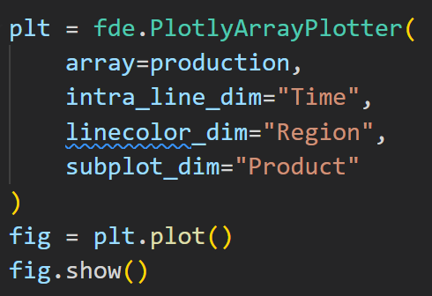
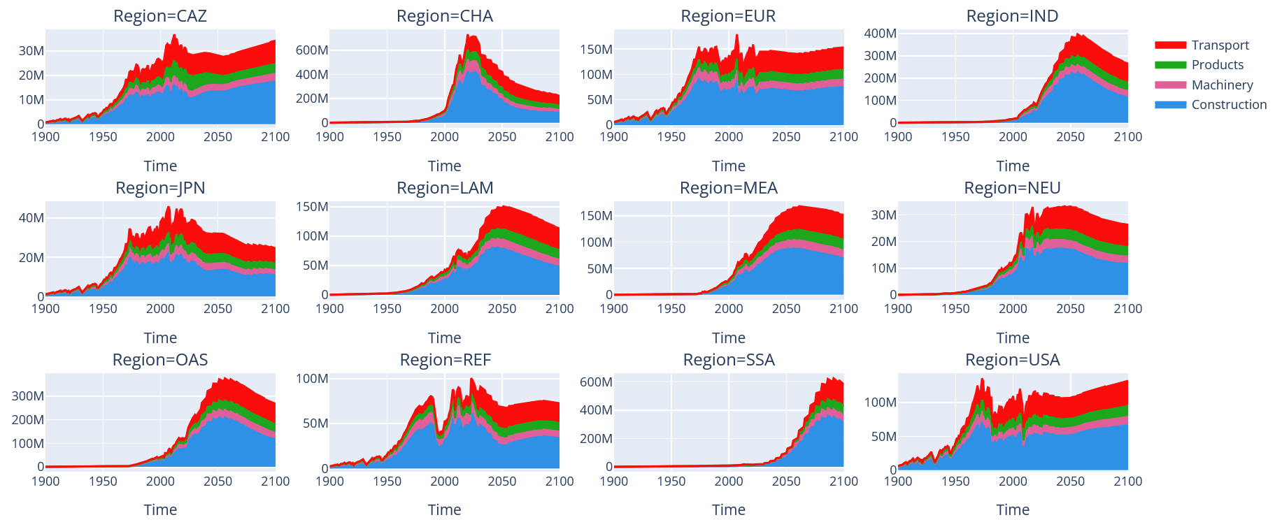
Import & Export
Pandas integration
Array plotting
fd.FlodymArray.from_df()
Checks data consistency
Orders data
Flags to allow missing/excess values
Performance-optimized for sparse data
fd.FlodymArray.to_df()
to_csv() directly possible
→ Flexible: You decide how to create data frames / what to do with them

Slide 14
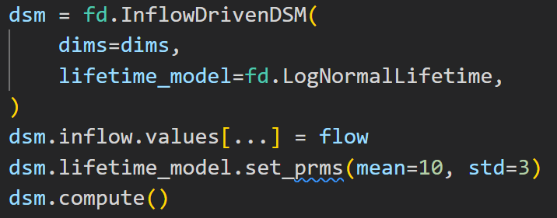
Dynamic Stock Models
Novel Features
Integrated in MFA system: Define, Initialize, compute like any other part of the system
Vectorized computation
Non-contiguous, non-uniform time steps
Sub-timestep lifetimes
Syntax

Slide 15
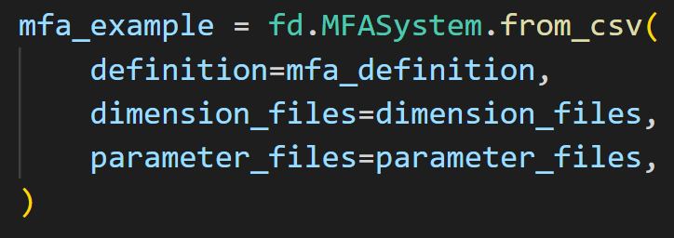
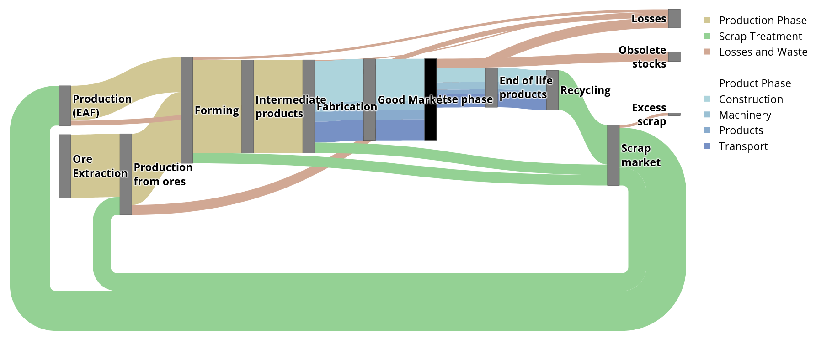
MFA Systems
Optional, but recommended
Easy integrated read-in from csv & Excel
System layout definition in Python, dimensions & coordinates from data
Integrated whole-system export
Sankey plotting
Mass balance & consistency checks

Slide 16
Application Example

Slide 17
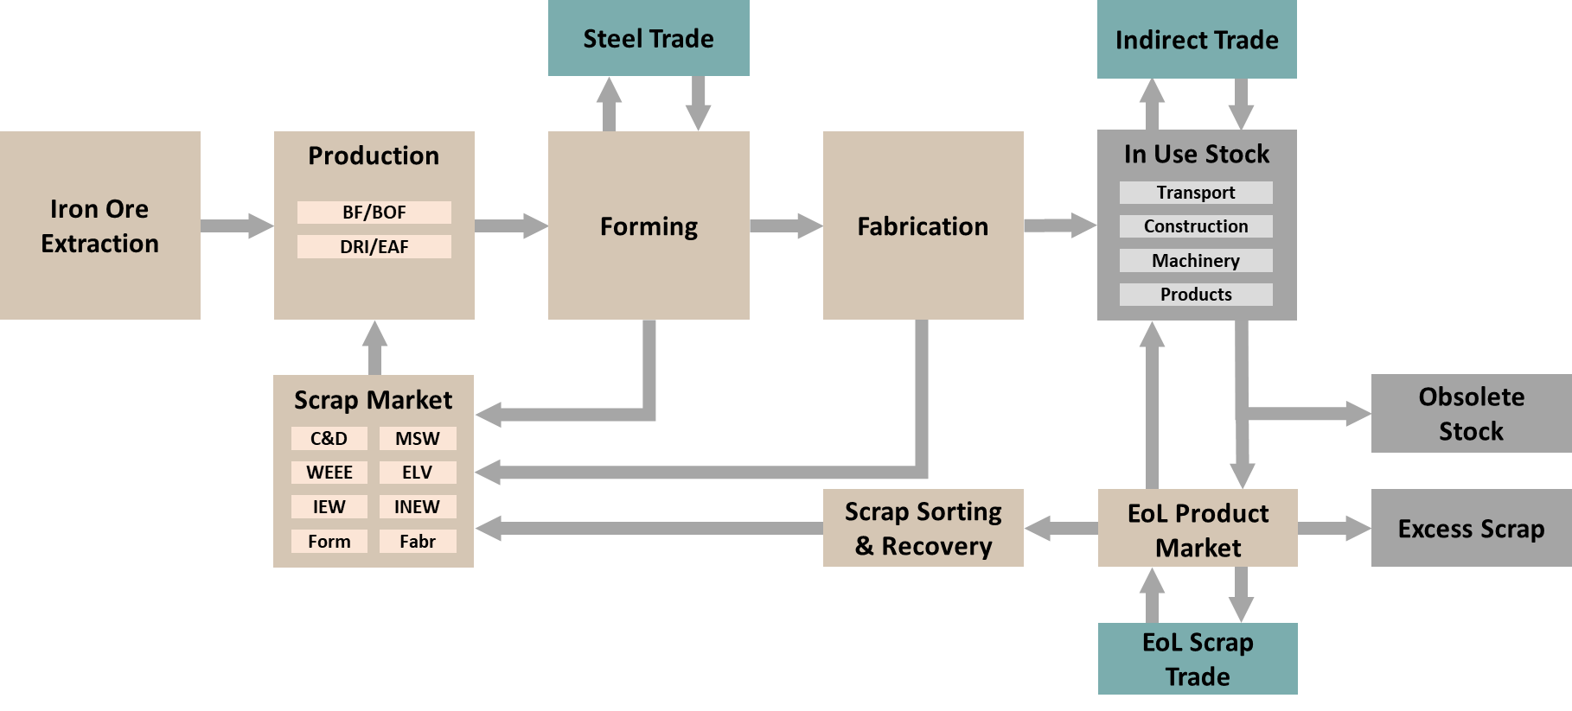
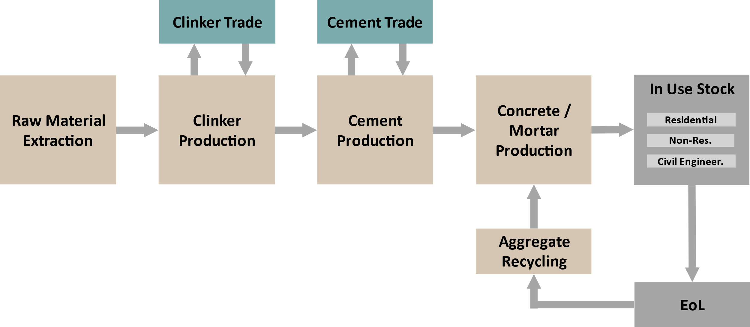
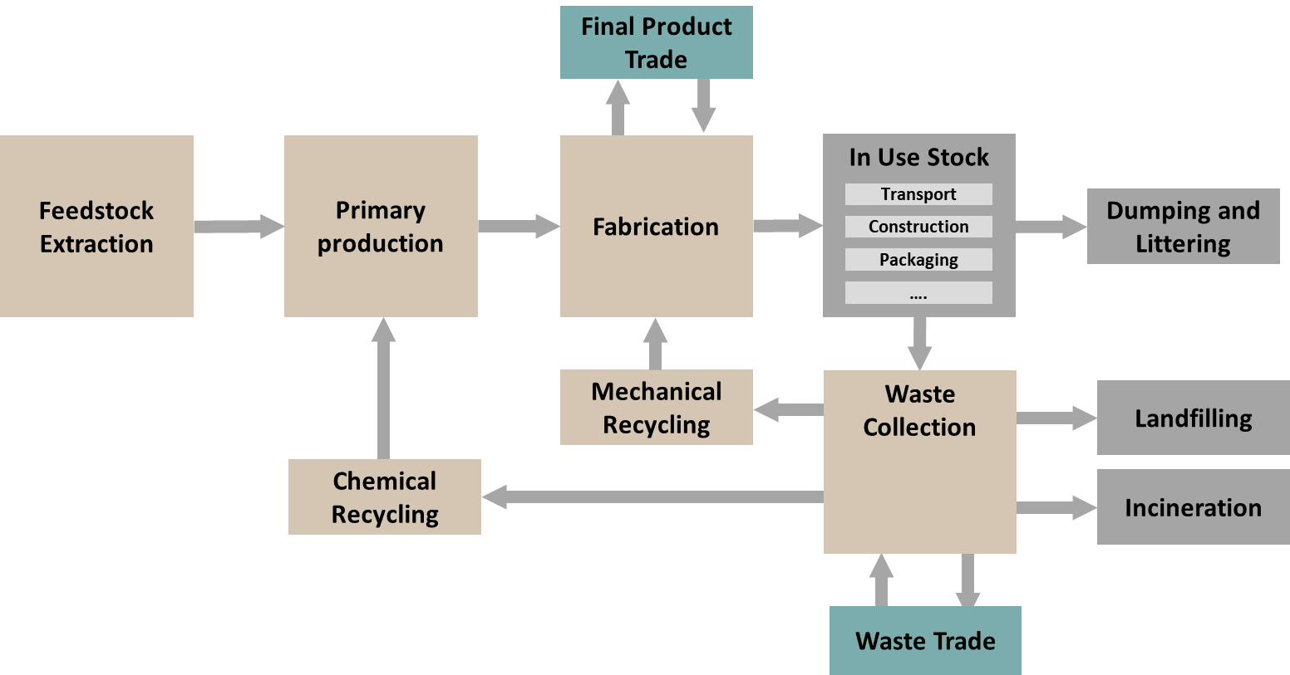
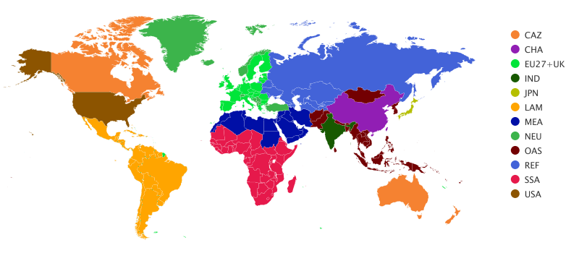
REMIND-MFA: Dynamic Material Flow Analysis Model
Steel
Cement
Plastics
Top-down, stock driven historic & prospective MFA
Developed for soft-link to the Integrated Assessment Model REMIND
12 global regions; input data generation allows for arbitrary regional resolution
Time: 1900-2100
Representation of circular economy methods

Slide 18
REMIND-MFA Example Results: Demand for Steel in Products

Slide 19
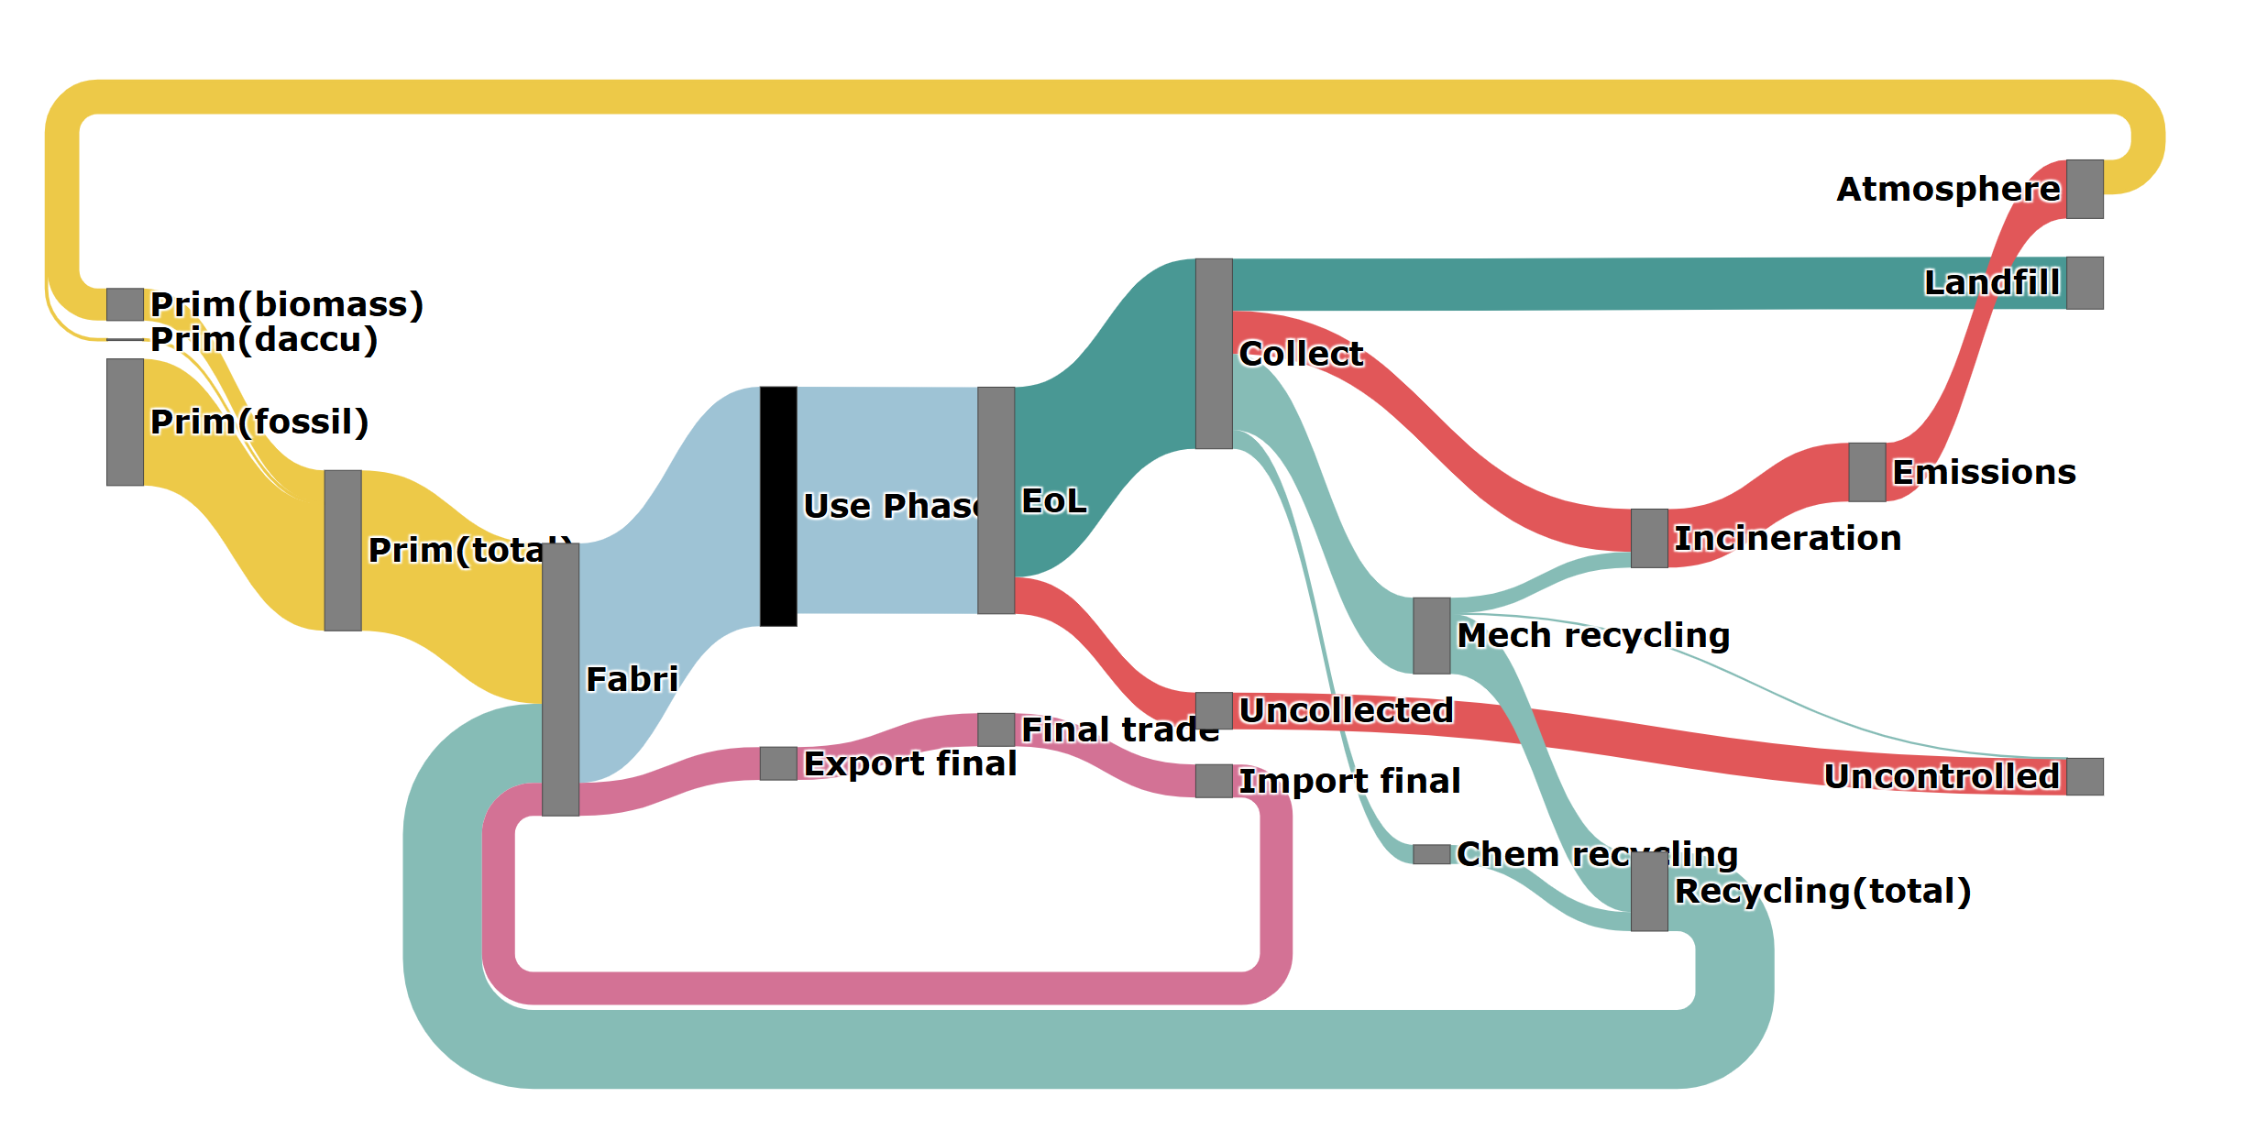
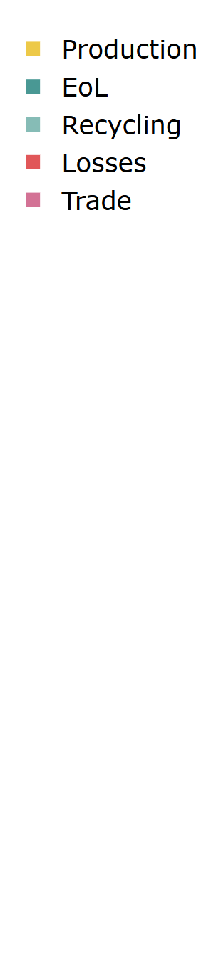
REMIND-MFA Example Results: Global Plastic Flows 2050

Slide 20
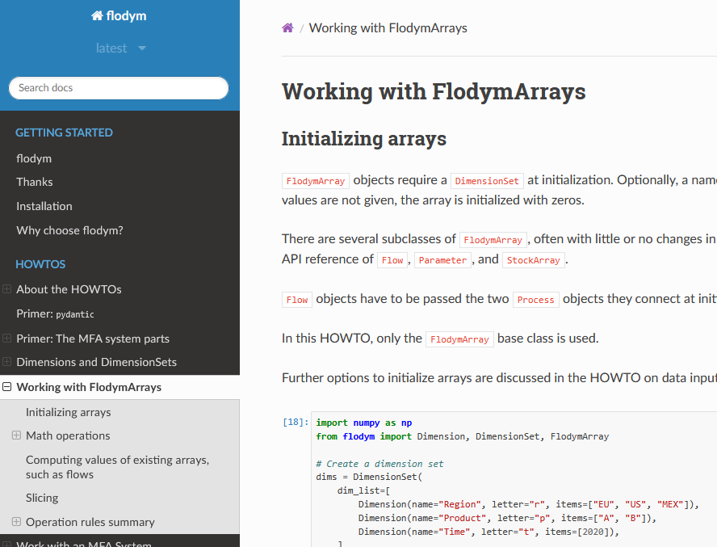
Resources
Installation: `pip install flodym`
Github: https://github.com/pik-piam/flodym
Documentation: https://flodym.readthedocs.io
Howtos
Examples
API Reference
Tuesday’s course: https://github.com/jakobbd/flodym_course
Publication (submitted): JOSS 2025 https://joss.theoj.org/papers/92b6faa2d82b8694f4ad5d394053ef32
Applications:
REMIND-MFA (in-house): https://github.com/pik-piam/remind-mfa
TRANSIENCE-EU-MFA (external): https://github.com/wupperinst/transience-eu-mfa

Slide 21







Thanks!
Authors
Jakob Dürrwächter
Bennet Weiss
Merlin Hosak
Falko Ueckerdt
Code
https://github.com/pik-piam/flodym
flodym.readthedocs.io
Notes:
And that’s all. We are the industry term in REMIND with different people working on different sector. And we are from IAM perspective, we are really looking forward the potential collaboration opportunities from Industrial ecology side, please Feel free to contact us!

